Slide 1
Chemical properties
Year 7 Science

Slide 2



Review

Slide 3
Learning Intentions
Mixtures, including solutions, contain a combination of pure substances that can be separated using a range of techniques.

Slide 4
Success criteria
Explain the difference between physical and chemical properties.
List or describe chemical properties.
Investigate slime

Slide 5
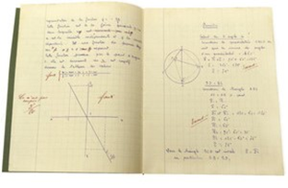
Chemical properties
A chemical property describes how a substance reacts with other substances.
When a substance reacts, it becomes a completely new substance.

Slide 6
Chemical properties include:
Combustion (burning or exploding with oxygen)
Corrosion (rusting in oxygen)
Reacts with or as an acid
Reactivity (reacts quickly or slowly with other chemicals)
9:04 AM

Slide 7
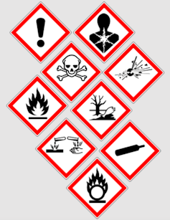
Activity: Slime

Slide 8
Success criteria
Explain the difference between physical and chemical properties.
List or describe chemical properties.
Investigate slime

